Slide 1
Service Oriented Architecture
A standards-based approach to managing services made available by different soft
ware packages for reuse and reconfiguration.

Slide 2
Introduction
Service-oriented architectures (SOA) is an emerging approach that addresses the requirements of loosely coupled, standards-based, and protocol independent distributed computing.
Service-oriented architecture is an approach to structuring a software system as a set of separate, stateless services.
An SOA is designed to allow developers to overcome many distributed enterprise computing challenges including application integration, transaction management, security policies, while allowing multiple platforms and protocols and leveraging numerous access devices and legacy systems

Slide 3
Continue…
The driving goal of SOA is to eliminate these barriers so that applications integrate and run seamlessly.
The simplest way to define a service-oriented architecture is as an architecture built around a collection of services with well-defined interfaces—similar to DCOM (Distributed Component Object Model) or Object Request Brokers (ORBs) based on the CORBA specification.
A system or application is designed and implemented as a set of interactions among these services.

Slide 4
Continue…
A service is a coarse-grained, discoverable, and self-contained software entity that interacts with applications and other services through a loosely coupled, often asynchronous, message based communication model.
Common communication models are:
Web services using Simple Object Access Protocol (SOAP) and Web Services Description Language (WSDL)
Message Oriented Middleware (MOM) such as IBM Websphere MQ
Publish Subscribe System such as Java Messageing Service (JMS)

Slide 5
Continue…
Service-oriented architecture (SOA) is a very popular architecture paradigm for designing and developing distributed systems.
SOA solutions have been created to satisfy business goals that include easy and flexible integration with legacy systems, streamlined business processes, reduced costs, innovative service to customers, and agile adaptation and reaction to opportunities and competitive threats.

Slide 6
Let’s go back on Software Architecture
One of the most valuable software engineering principles is to introduce inspection points into the software life cycle.
Software architecture evaluation is a particularly important inspection point, because architecture is the bridge between business goals and the software system.
Choosing and designing an architecture that satisfies functional as well as quality attribute requirements (e.g., availability, security, and performance) is vital to the success of the system.
Architectural decisions have a deep and broad effect on downstream development stages.
Early evaluation of the requirements and the architecture saves time and money, because fixing defects once the code is fielded is at least three times more costly

Slide 7
SOA: Introduction
In SOA , there are service providers—elements offering services to be used by others— and service users—elements that invoke services provided by others.
These categories are not mutually exclusive.
A service provider may use other services, and a service user may provide a service interface.
In contrast to conventional software architectures primarily delineating the organization of a system in its (sub)systems and their interrelationships, the SOA captures a logical way of designing a software system to provide services to either end-user applications or other services distributed in a network through published and discoverable interfaces.

Slide 8
Continue…
There are many definitions of SOA but none are universally accepted. What is central to all, however, is the notion of service.
For an SOA, a service
• is self-contained. The service is highly modular and can be independently deployed.
• is a distributed component. The service is available over the network and accessible through a name or locator other than the absolute network address.

Slide 9
Continue…
• has a published interface. Users of the service only need to see the interface and can be oblivious to implementation details.
• stresses interoperability. Service users and providers can use different implementation languages and platforms.
• is discoverable. A special directory service allows the service to be registered, so users can look it up.
• is dynamically bound. A service user does not need to have the service implementation available at build time; the service is located and bound at runtime.

Slide 10
Now Again on SOA
SOA is defined as an architectural style where systems consist of service users and service providers.
An architectural style defines a vocabulary of component and connector types, and constraints on how they can be combined

Slide 11
Some of the constraints that apply to the SOA architectural style
Service users send requests to service providers.
A service provider can also be a service user.
A service user can dynamically discover service providers in a directory of services.

Slide 12
SOA and Web Services
SOA is an architectural style, whereas Web services is a technology that can be used to implement SOAs.
The Web services technology consists of several published standards, the most important ones being SOAP and WSDL.
Other technologies may also be considered technologies for implementing SOA, such as CORBA.
Although no current technologies entirely fulfill the vision and goals of SOA as defined by most authors, they are still referred to as SOA technologies.
The relationship between SOA and SOA technologies is represented in next slide

Slide 13
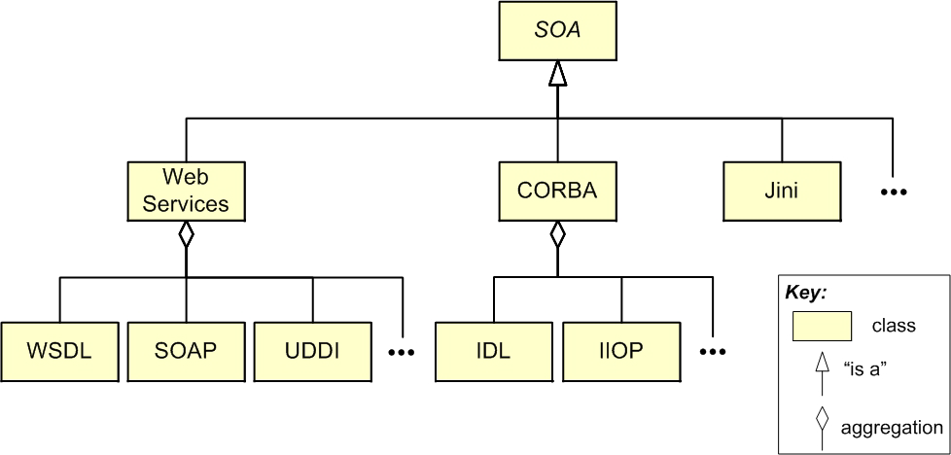
SOA and SOA Technologies

Slide 14
SOA : Architectural Approach
In an architecture evaluation, we often don’t have time to look at all the architectural elements of the system.
Architecture evaluators understand how different architectural approaches and patterns affect quality attributes.
Therefore, to evaluate whether a software architecture can meet the quality attribute requirements, we can focus on the architectural approaches used in the system.
For the evaluation of an SOA system, we focus primarily on service integration and communication patterns, rather than the architectures of the underlying integrated applications.

Slide 15
SOA Communication Approach
Each interaction between a service user and a service provider in an SOA can be implemented differently.
The implementation alternatives impact important quality attributes of the system, such as interoperability and modifiability.
In a pure Web services solution, the SOAP protocol is used. However, the architect can also avoid SOAP and use a simpler approach, such as Representational State Transfer (REST).
Another option is to use messaging systems, such as Microsoft MSMQ and IBM WebSphere MQ (previously called MQSeries).
These alternatives and related quality attribute concerns are discussed now onwards.
An SOA environment may involve a mix of these alternatives along with legacy and proprietary communication protocols, such as IIOP, DCOM, DCE, and SNA/LU6.2.

Slide 16
SOAP-Based Web Services
Web services is a technology commonly used to implement SOAs.
Service interfaces are defined in the WSDL language, and service users and service providers communicate using the SOAP protocol.
Two attributes in a WSDL interface, “style” and “use,” define the SOAP communication between service users and providers.
The style attribute has two possible values: “RPC” and “document.”
The use attribute refers to data encoding and has two possible values: “encoded” or “literal.”
Consequently there are four possible combinations of these two attributes.
Two combined options that are common in practice are RPC-encoded and document-literal.

Slide 17
RPC-Encoded SOAP
In the RPC style, the SOAP message is equivalent to an XML-based remote method call.
The name and type of each argument is part of the WSDL interface definition.
The body of the SOAP request necessarily contains an element indicating the operation name and sub-elements corresponding to the operation arguments.
The encoded attribute indicates that data is serialized using a standard encoding format.
This format is defined by the SOAP specifications and contains rules to encode primitive data types, strings, and arrays.

Slide 18
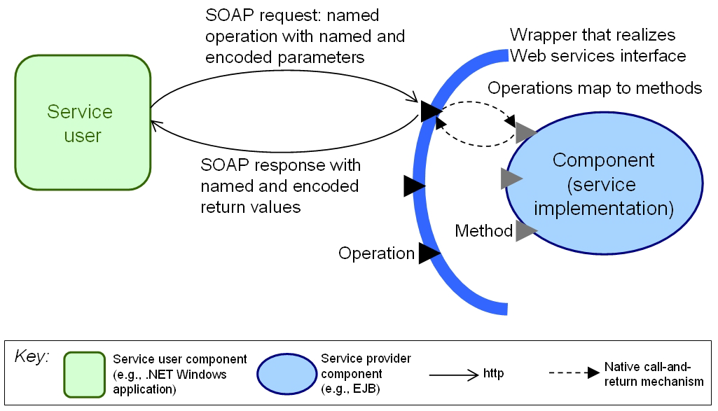
RPC Encoded Interaction

Slide 19
Document-Literal SOAP
The SOAP message body in a document-literal style request can contain arbitrary XML (the business document).
The WSDL definition does not have to specify named parameters, and the XML content of the message body does not follow a standard structure as in the RPC style.
The literal attribute indicates that no standard encoding format is used—data in the SOAP body is formatted and interpreted using the rules specified in XML schemas created by the service developer.
The XML schemas that define the data structure of the request and the response are the key elements in the interface definition.

Slide 20
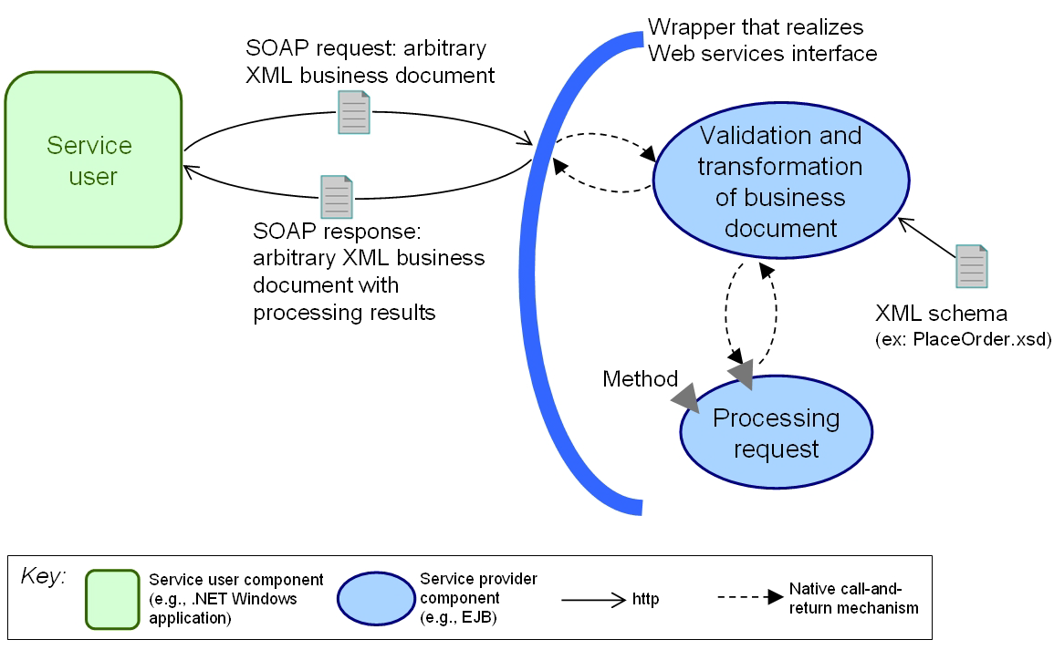
Document Literal Interaction

Slide 21
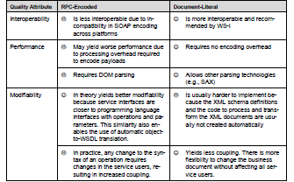

Slide 22
REST(Representational State Transfer)
REST was proposed by Roy Fielding [Fielding 2000].
It avoids the complexity and processing overhead of the Web services protocols by using bare http.
As an example, consider a weather forecast service that is publicly available and is provided by http://www.weather.com.
One important REST concept is a resource, which is a piece of information that has a unique identifier (e.g., a uniform resource identifier (URI)).

Slide 23
Continue…
For the weather service, examples of resources include
current weather for zip code 15213
weather forecast for tomorrow for the Kathmandu city
10-day weather forecast for zip code 15213
temperature averages for the Kathmandu city in October

Slide 24
Continue…
In the previous example, there are three types of resources: current weather, weather forecast, and temperature averages.
We can structure the URIs of the resources based on these three types.
Parameters can be represented by elements in the URI hierarchical path or [key]=[value] pairs.

Slide 25
Continue…
REST relies on the http protocol for the interaction between service users and providers.
The http protocol has four basic operations: POST, GET, PUT, and DELETE.

Slide 26
REST Vs SOAP
REST advocates claim several benefits over SOAP-based Web services:
REST results in improved modifiability.
For a service user to interact with a non-REST Web Service, the service user has to understand the specifics of the data contract (i.e., how data is structured) and the interface contract (i.e., what operations can be performed).
Because of the uniform interface, to invoke a REST service, the service user only has to understand the data contract, because the interface contract is uniform for all services.

Slide 27
Continue…
REST is easy to implement and yields high interoperability, since it only requires standard http support from both the service user and provider.
It doesn’t require SOAP toolkits to implement the code or an application server that supports Web services.
REST has better performance due to its ability to cache the responses (when applicable) and to the absence of the intermediaries, message wrapping, and serialization that are required by Web services.

